Slide 1
Terms
YEARBOOK TERMS

Slide 2
Yearbook Components
Yearbook Basics
Sections of the Book
Theme & Incorporating Your Theme

Slide 3
The yearbook is printed in 16-page mini-booklets.
YEARBOOK BASICS
Each signature (mini-booklet) begins as a giant sheet of paper with eight pages printed on each side, called a multiple.
After the sheet is printed on both sides, it is folded into booklet form and trimmed, forming 16 consecutive pages.

Slide 4
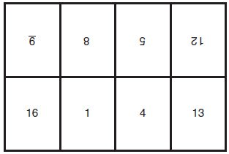
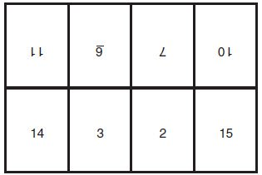
Multiple 1 - Pages are printed as seen below on one side of the sheet of paper.
Multiple 2 - Pages are printed as seen below on the other side of the sheet of paper.
YEARBOOK BASICS
Once all pages have been printed, the paper is folded and cut, forming 16 consecutive pages called a signature.
Multiple 1
Multiple 2
Notice: The pages are not printed consecutively and the top of each page faces the center fold of the sheet of paper.

Slide 5
What is a Ladder?
YEARBOOK BASICS
Page-by-page planner and deadline tracker used to identify content, record deadlines, plan color placement and track pages submitted and proofed.
The ladder is organized by spreads, multiples and signatures.
The ladder should be completed before yearbook production begins.
Efficient to use a paper ladder (located in your yearbook kit) and an electronic, editable ladder.

Slide 6
More than just a Cover
YEARBOOK BASICS
The cover presents the year’s unique theme showcasing fonts, colors and graphics that will be used inside the book.
The cover consists of the front lid, the back lid and the spine/backbone.

Slide 7
Endsheet
YEARBOOK BASICS
The heavy paper between the cover and the first and last pages is used to hold the signatures in the yearbook.
Endsheets can be designed by the staff to complement the cover.

Slide 8
YEARBOOK BASICS
Cover
Castle View High School / CO

Slide 9
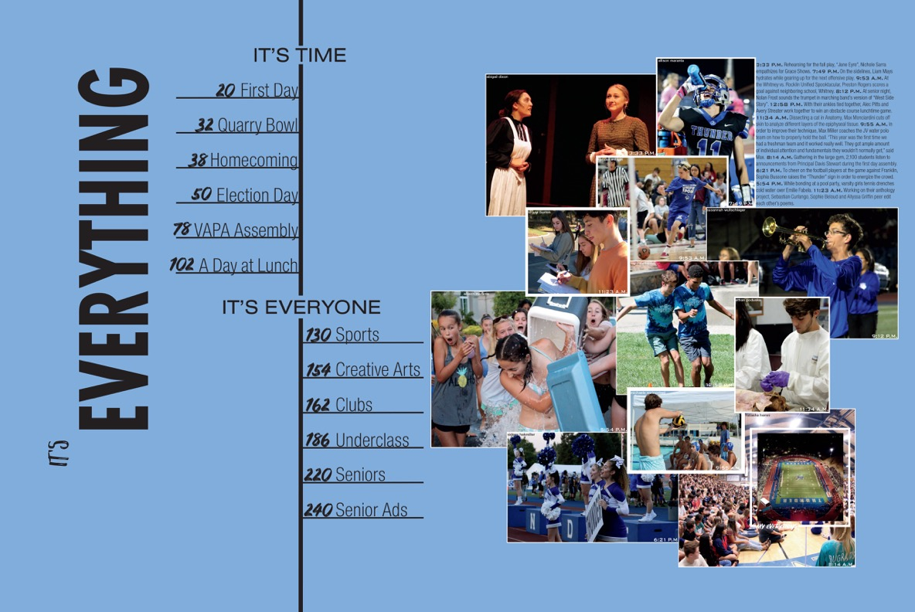
YEARBOOK BASICS
EndSheet
Rocklin High School / CA

Slide 10
YEARBOOK BASICS
DEFINTIONS
Double Page Spread (DPS): Two facing pages telling a story.
Page: A single page of content with the opposite page featuring a different, yet often related topic.
Page Numbers: Also called folio or folio tabs, they provide specific quick references for readers. Ex: “Page 26 - Varsity Football.”
Byline: The name of the author(s) of the spread/page/mod. Can be added to the end of the feature story or as part of the folio.
Content Module (or Mod): Portion of a page/spread containing a mini-design of photos/text; can be displayed with other content modules to present different angles on the same topic.

Slide 11
Traditional Coverage includes the following sections:
YEARBOOK BASICS
Title Page, Table of Contents, and Opening
Consider placing the table of contents on the endsheet or title page (page 1). Also, this would be a good place to put the school information and theme (page 1).
Sports Section
Highlights the athletic events of your school
Academics Section
Should highlight the exciting and interesting things going on in the classroom.

Slide 12
SECTIONS OF THE BOOK
Traditional
Clubs/Organizations Section: Records the happenings of the clubs that exist in your school (school sponsored and student sponsored).
People Section: School “mug shots” of all students and staff in the school.
Student Life Section: Highlights activities that take place in the lives of students in and outside of school.

Slide 13
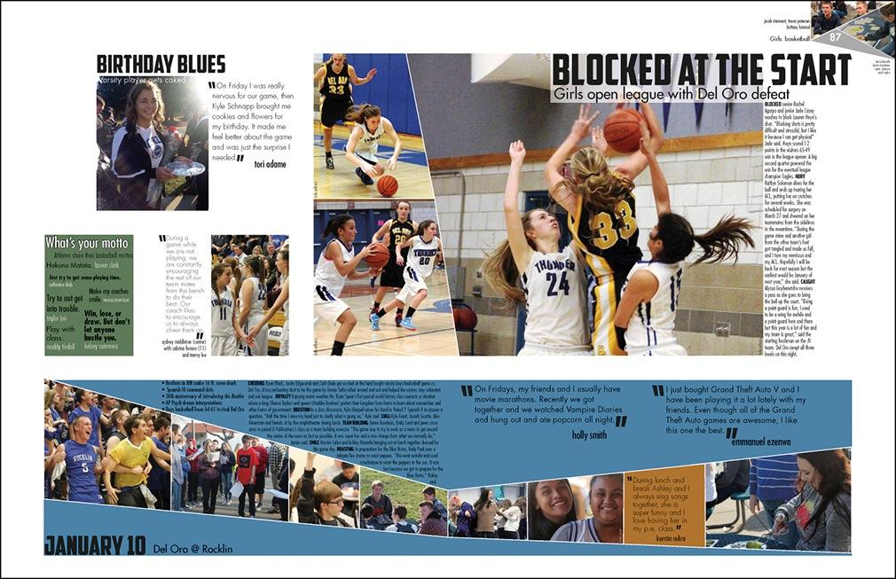
SECTIONS OF THE BOOK
Sports
Del Oro High School / CA

Slide 14
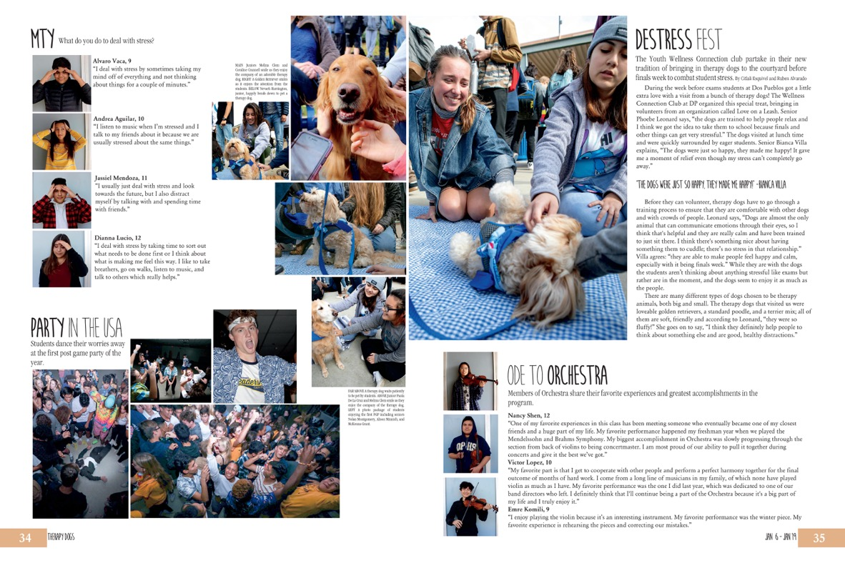
SECTIONS OF THE BOOK
Student Life
Dos Pueblos High School / CA

Slide 15
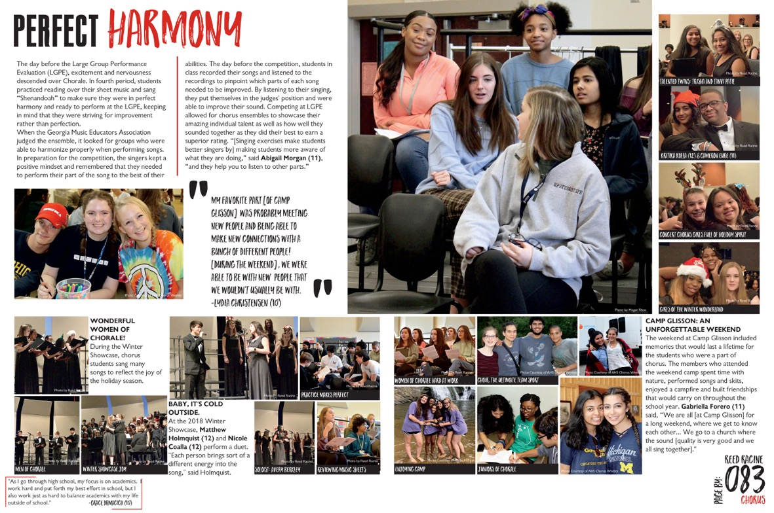
SECTIONS OF THE BOOK
Organizations
Alpharetta High School / GA

Slide 16
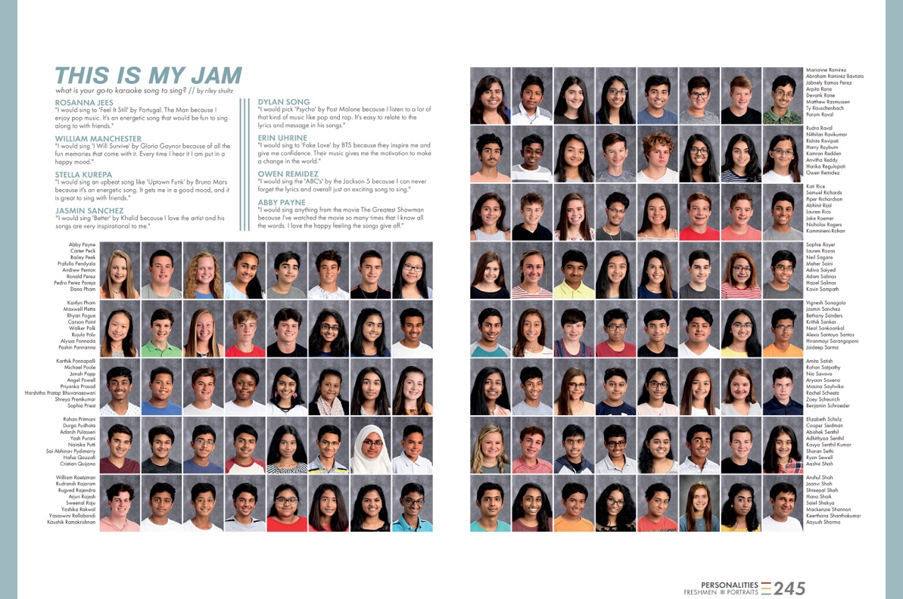
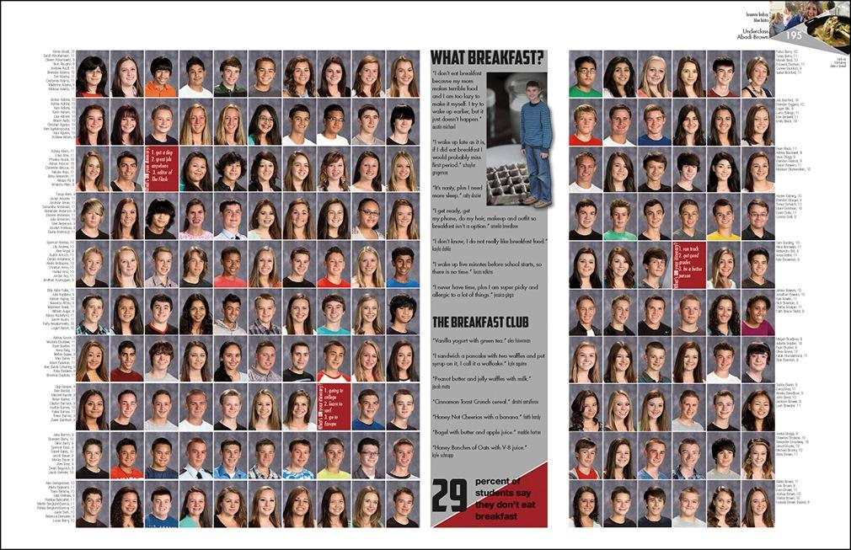
SECTIONS OF THE BOOK
People
Coppell High School / TX

Slide 17
SECTIONS OF THE BOOK
Chronological
Chronological yearbooks: One that progresses through time, rather than the traditional sections of People, Academics, Organizations, Student Life, Sports and Ads, can take several forms.
The book can be structured by seasons, months, weeks or days.
One of the biggest advantages is that it is easier to meet deadlines because the yearbook staff is taking photos, gathering stories and creating spreads as events unfold.

Slide 18
SECTIONS OF THE BOOK
Traditional AND Chronological
Advertising/Community Section
Used as a fundraiser, personal (or recognition) ads are created by family members to celebrate their graduating student. Other options include friendship, accomplishments, etc.
Also used as a fundraiser, business (or patron) ads are sold by yearbook staff members and allow local businesses to advertise in the book.
Reference Section
Athletic team shots and club group shots (with names) can be placed in the back of the book to save space on content spreads.
Index
A record of who is in the book and where the reader can find them. Can include photos for more coverage.

Slide 19
SECTIONS OF THE BOOK
Advertisements
Orono High School / MN

Slide 20
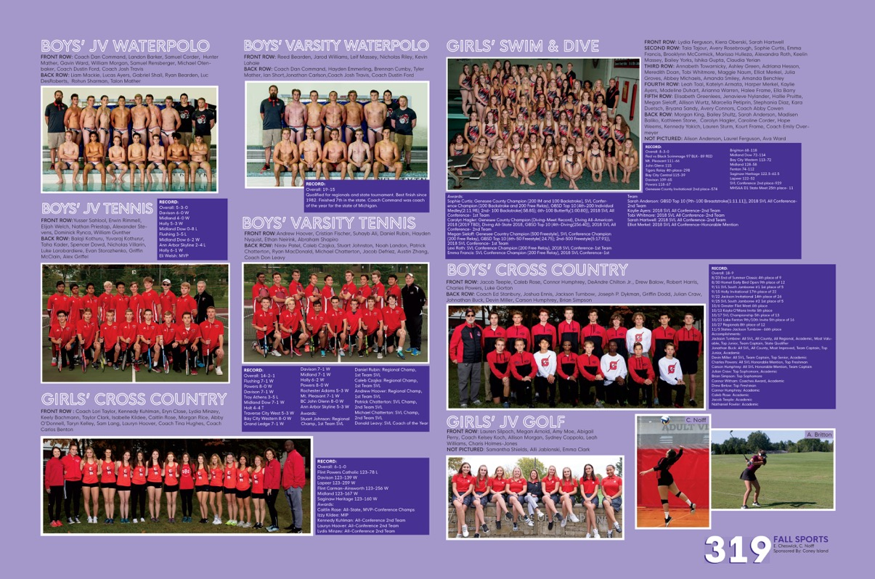
SECTIONS OF THE BOOK
Reference
Grand Blanc High School / MI

Slide 21
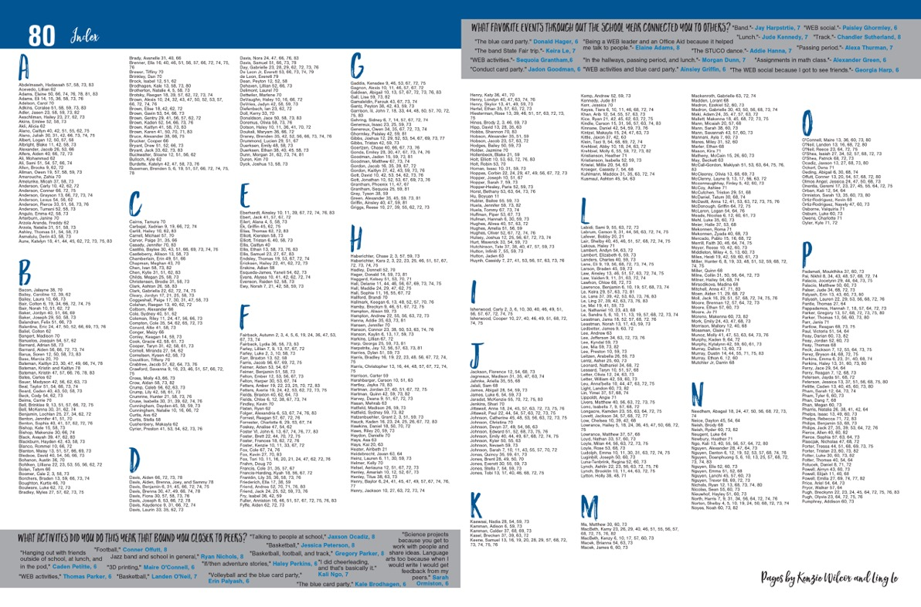
SECTIONS OF THE BOOK
Index
Andover Middle School / KS

Slide 22
THEME
Theme: A central idea or concept that sets the tone for telling the story of the year. Repeated throughout the yearbook on cover, endsheets, opening, closing and dividers, it unifies the storytelling message of the book and gives it personality.
Logo
Color
Graphic
Typography
How to incorporate your theme into the book:

Slide 23
INCORPORATING YOUR THEME
Ways to incorporate the theme in your book:
Logo
Choose type styles and a design that convey the meaning, tone and style of the theme. In the design, emphasize a key word or phrase. For example, in the theme “On the Move,” you could set the word “move” in large italicized type to imply motion.
Colors
Repeat colors introduced on the cover throughout the book. Take advantage of obvious color opportunities in themes such as “Out of the Blue.”
Graphics
Lines, tints, screens and textures can help emphasize specific areas within designs.
Typography
Use selected fonts only to enhance the theme. Body copy should be simple and readable.

Slide 24
INCORPORATING YOUR THEME
Opening
Gives an introduction to your theme and starts the book out on that note.
Closing
Finishes the story of the year and brings the book closure.
Dividers
Pages/spreads that indicate new sections and provide continuity with your theme.

Slide 25
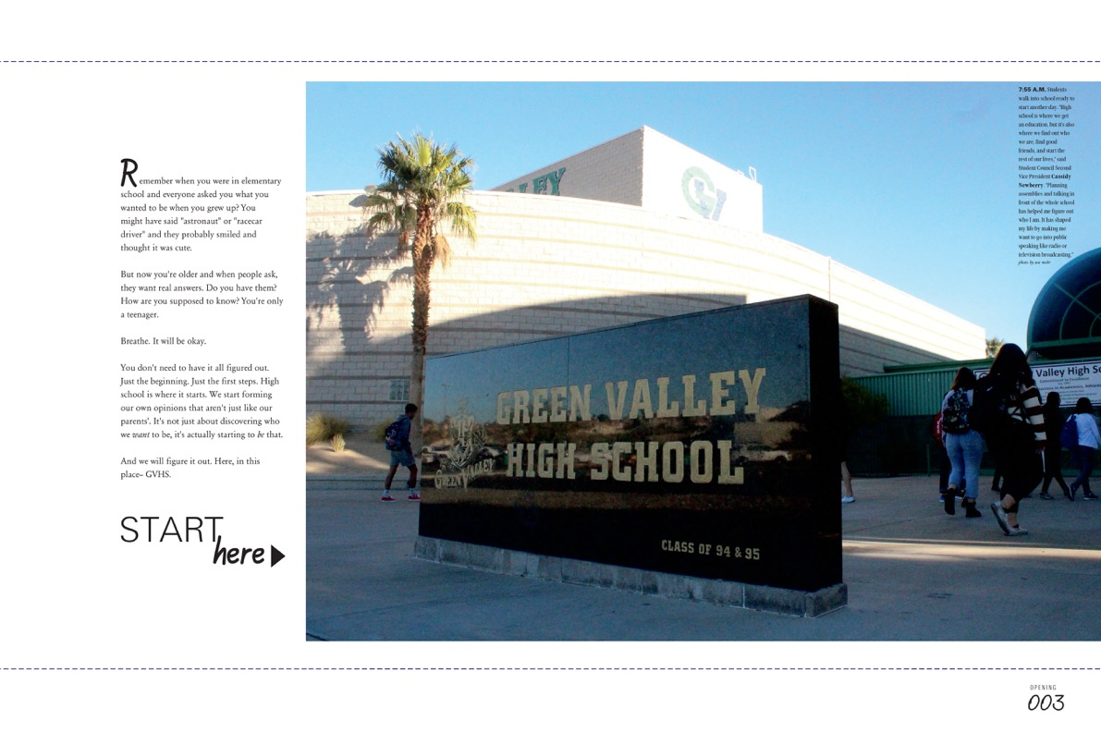
SECTIONS OF THE BOOK
Opening
Green Valley High School / NV

Slide 26
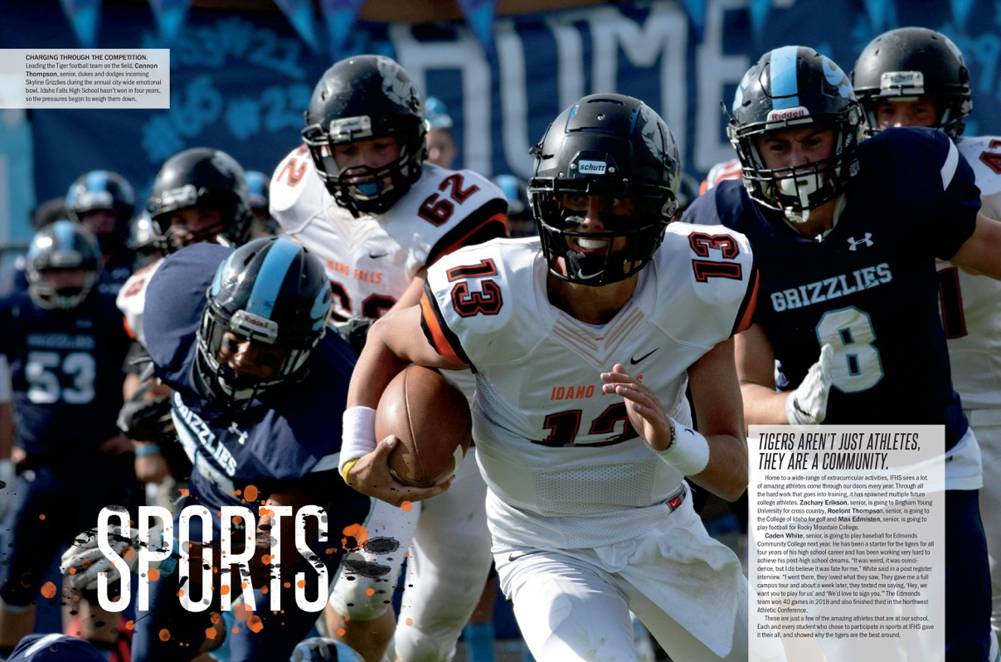
SECTIONS OF THE BOOK
Divider
Idaho Falls High School / ID

Slide 27
Putting it Together
Writing Elements
Design Elements
Photography Elements

Slide 28
WRITING ELEMENTS
Headline
Introduces the reader to the page by summarizing the story of the page or highlighting its focus. Should use literary devices to be clever or eye-catching.
Subheadline
Accompanies the primary headline. It is short and catchy, and offers specific information and added details about the story subject.
Feature Story
Usually 3-5 paragraphs, a feature story tells about the event and gives more insight and detail than a caption can. It is a traditional method of telling about an event.

Slide 29
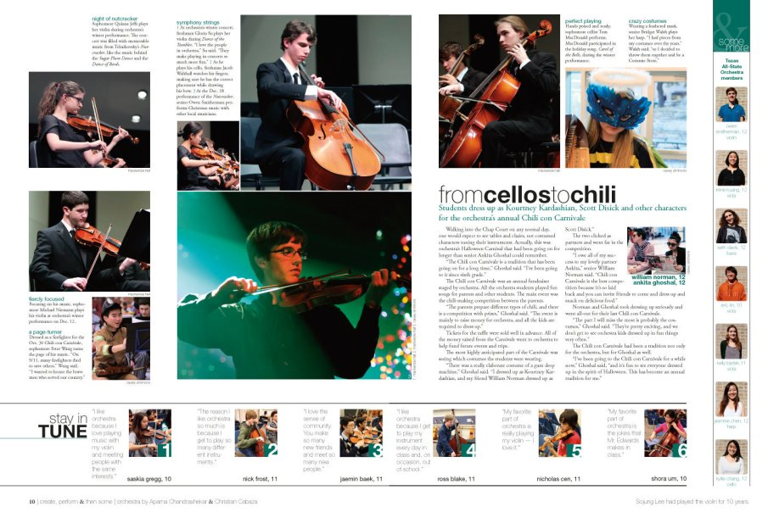
HEADLINES
Alliteration
Subheadline
Play on Words
Westlake High School / TX
Feature Story

Slide 30
WRITING ELEMENTS
Caption: tells the reader more about the photo than they can simply see. There are 4 main types of captions:
Indent
Captions simply identify the subject of the photo with their name and grade.
Summary
Captions are 1-2 sentences and provide more information not visible in the photo.
Expanded
Group
Group captions are for sports and club team shots to identify the subjects of the photos left to right, bottom row to top row.
Quotes can be added to a summary caption to create an expanded caption.

Slide 31
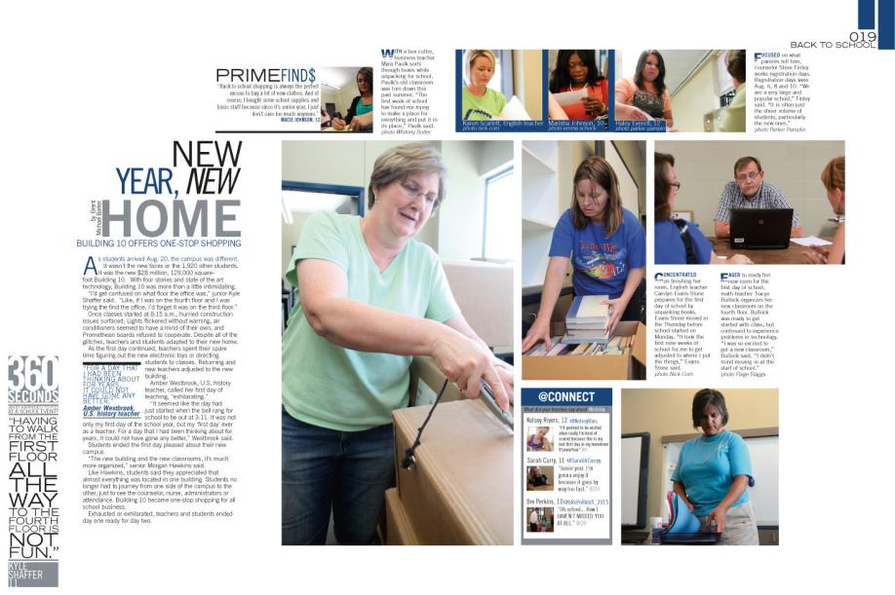
CAPTION
Caption
Bryant High School / AR

Slide 32
WRITING ELEMENTS
Quick Reads/Infographics: Offer the reader (and yearbook staffer) a different way to view information on a yearbook spread.
They’re often packaged with graphics. Examples include:
Figures: table, index, listing, stats, chart, scoreboard, pie chart
Facts: fact box, listing, top 10, summary points, informational map, diagram, definitions, profile
Opinions: quotes, question-answer, for/against, personal narrative, journal, advice
Time: schedule, calendar, timeline
Interactive: fill-in, matching, connect the dots, color an object, check test, crossword puzzle, word search, quiz

Slide 33
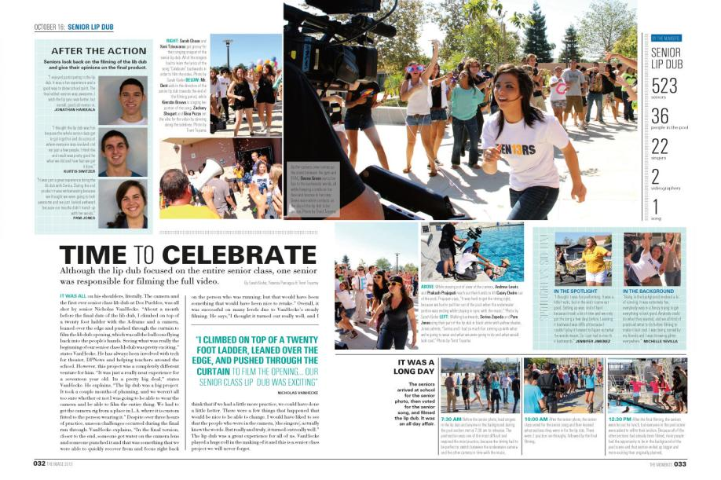
DESIGN TERMS
Infographic
Quick Read
Palos Verdes High School / CA

Slide 34
DESIGN TERMS
Gutter
The spine of the yearbook, where the left page meets the right page.
Avoid placing subjects of photos and text across the gutter- photos can cross the gutter as long as the subject’s face is visible.
Pica
A unit of measurement in yearbook. 6 picas (or squares) represent 1 square inch. There are 12 points to a pica, therefore a half pica is 6 points.

Slide 35
DESIGN TERMS
Trim Line
All critical information must be placed inside the trim line. Any elements that cross this line “bleed” off the edge of the page.
Internal Spacing
Using picas as a guide, internal spacing determines the distance between elements on a spread. Use tighter internal spacing inside modules, and larger internal spacing between modules.
Internal spacing helps your reader separate content.

Slide 36
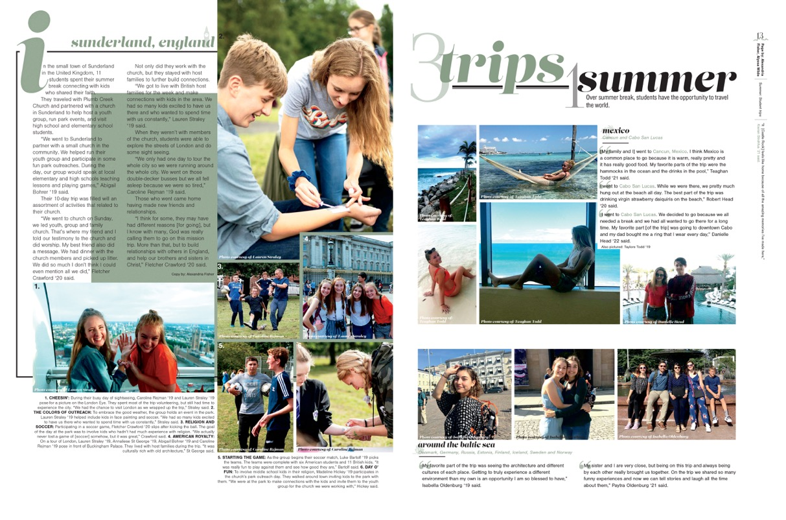
QUICK READS/INFOGRAPHICS
2.
1.
3.
1. Pica
2. Internal Spacing
3. Gutter
Castle View High School / CO

Slide 37
DESIGN ELEMENTS
White Space
Planned open space on a page used to frame or otherwise highlight content.
Layout
The layout is the template for your pages. It organizes all your design elements so that you can place them later.
Structure
By using columns and guides, your pages will be uniform and even.

Slide 38
DESIGN ELEMENTS
Dominance
Each page should have a dominant element on the design. This may be a photo or a connected group of photos.
Contrast
Try to mix up elements and sizes of photos on your page to create contrast and variety, increasing reader appeal.
Eyeflow/Eyeline
This is the invisible (or white space created) line that runs across the DPS, helping connect the two pages and keeping the reader’s visual flow.

Slide 39
DESIGN ELEMENTS
Linkage
Each DPS (double-page spread, remember?) should be designed as one unit, not two separate pages. Linkage helps readers stay on the pages longer and make things look more unified.

Slide 40
PHOTO TERMS
Visual storytellers
Types of Photos (candid = NOT posed)
Dominant: The largest photo on the page, must be a strong emotional or action shot to catch the attention of the audience.
Action: Candid capturing the peak of action
Reaction: Candid illuminating emotional responses
Scrapbook/environment: posed photos featuring unique personalities (should be used sparingly)
COB: cut-out background photo
Selective Color: part black/white, part color photo

Slide 41
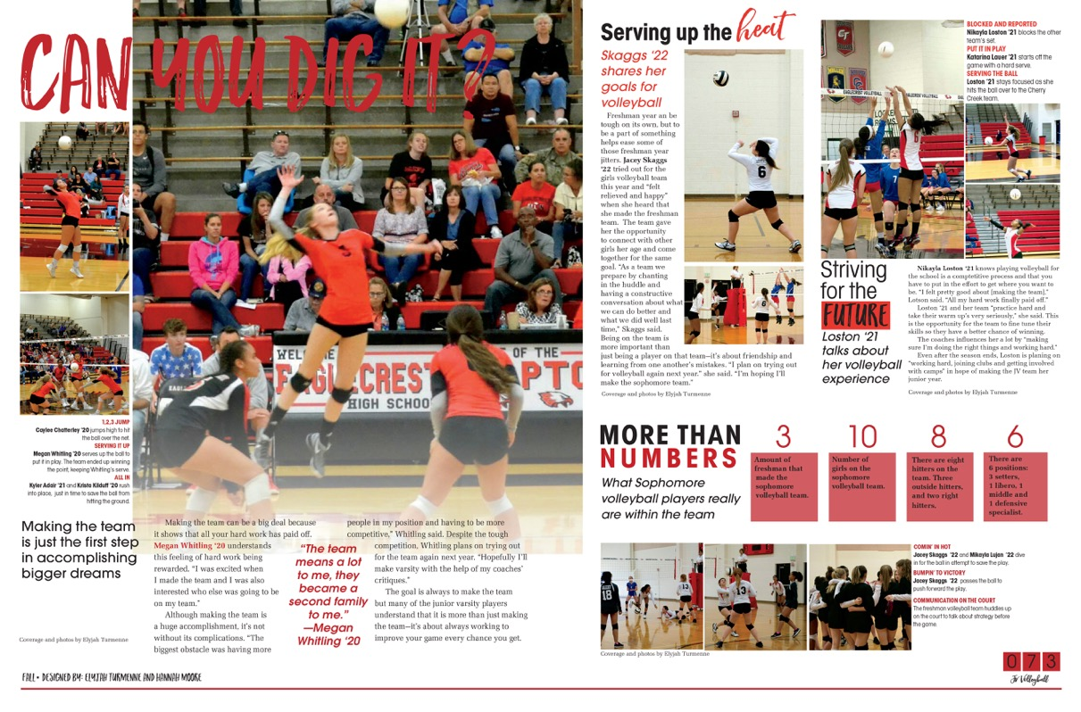
DESIGN ELEMENTS
6.
2.
1.
5.
1. Dominance
2. Linkage
3. Contrast (in shapes and size)
4. White Space
5. Eyeline
6. Structure
3.
4.
Eaglecrest High School / CO

Slide 42
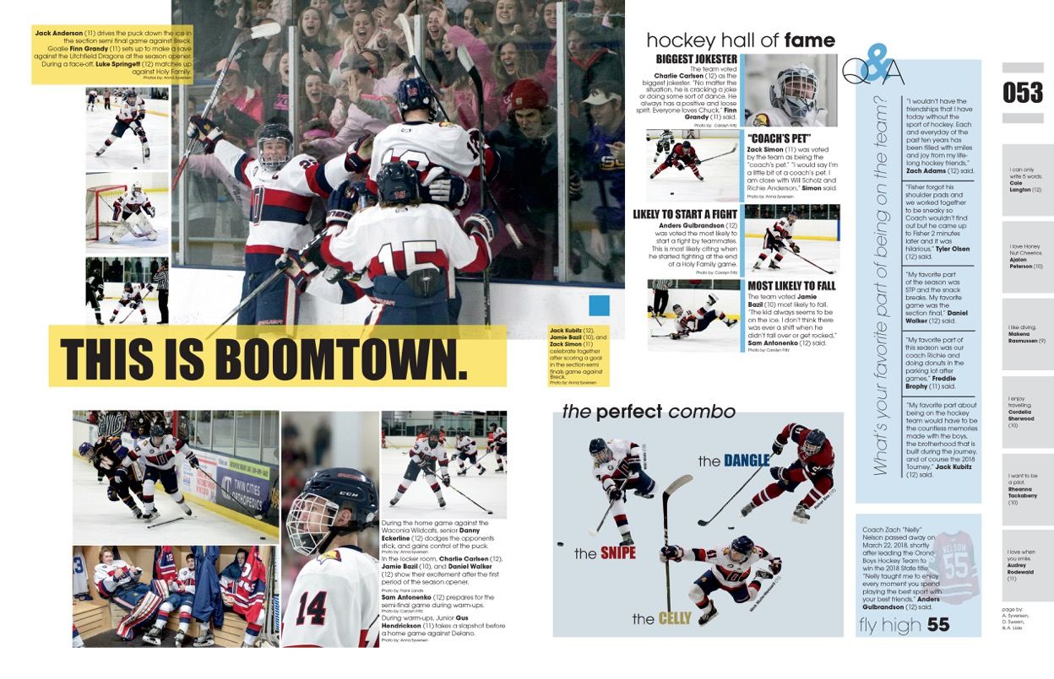
PHOTO VARIETY
4.
2.
1.
1. Smaller Horizontal Photos
2. Smaller Vertical Photos
3. Cut Out Background (COB)
4. Large Dominant Photo
3.
Plano Senior High School [TX]
Orono High School / MN
Notes:
Single shot: one image used to tell the story
Series: three or more photos showing the sequence of events
Collection: group of related photos each telling a different aspect of the story
Cut-out-background (COB): removing the background of a photo, leaving just the subject
Mortise: smaller, related photo that overlaps or is inset into a larger photo

Slide 43
Your Printing Partner
What is Jostens?
Jostens Terms

Slide 44
What is Jostens?
The company that prints and publishes your yearbook
Jostens Rep
Your connection to the publisher, information, and an advocate in completing deadlines, meeting budgets, planning, creating, etc.
Jostens Plant Consultant
Your connection in creation of your yearbook at the plant level.
Jostens Tech Support
The call-in support system that can help you with any computer related issues.

Slide 45
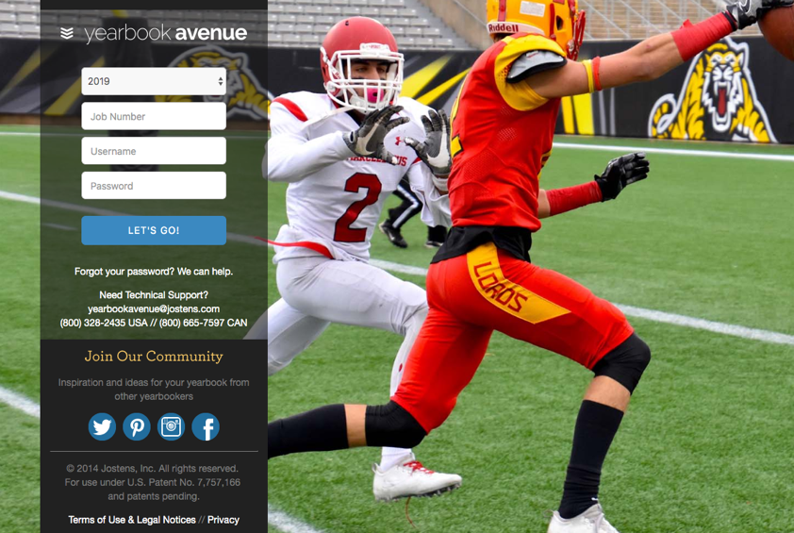
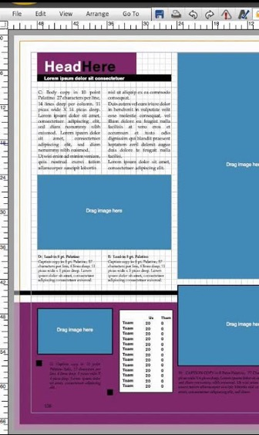
Jostens Terms
Yearbook Avenue (YBA): Access to tools to create, sell, and promote your yearbook. YBA includes record keeping software, page generators, coverage reports, etc. to ensure your staff runs smoothly.

Slide 46
Jostens Terms
Layout Pro and Monarch
Creation software that allows one to create their yearbook online. Inside YBA, one can login to the book anywhere there is internet.
Tag
The ability to mark photos with names of individuals who appear in the photos. Tagging photos allows for better coverage and easy indexing.
Coverage Report
An option on YBA that displays the number of times individuals appear in the yearbook (photos must be tagged) and the page numbers on which they appear. The coverage report also allows for easy access to correct spelling of names.

Slide 47
Jostens Terms
Digital Classroom
Within the Yearbook Avenue website, the Digital Classroom houses videos, worksheets, handouts and activities for use in a yearbook class.
Deadline
The date that completed yearbook pages are due at the Jostens plant. Meeting all deadlines is essential to keep the delivery of the yearbook on schedule.
Personalization
The opportunity for an individual to add their name, crest or logo to the front of their yearbook.

Slide 48
Jostens
Questions
?

