Slide 1
2021—2022
Studio Screened Covers

Slide 2
A New Way to View Covers
The following slides contain 10 Studio Screened cover designs available for the 2021—2022 school year. Use this presentation to preview all covers and narrow down your selection for the best yearbook cover ever!
Tips for narrowing down cover designs:
Hide or delete the cover designs you’re not interested in.
Switch to a grid view (View > Slide Sorter) to view several designs at once and move your favorites to the top.
Save your favorite designs as images (File > Export > Change File Type > JPEG) to share via Kahoot, Google Form, etc. and have a larger audience vote on them.
Choose one of the following icons to copy and paste onto your favorite designs.

Slide 3
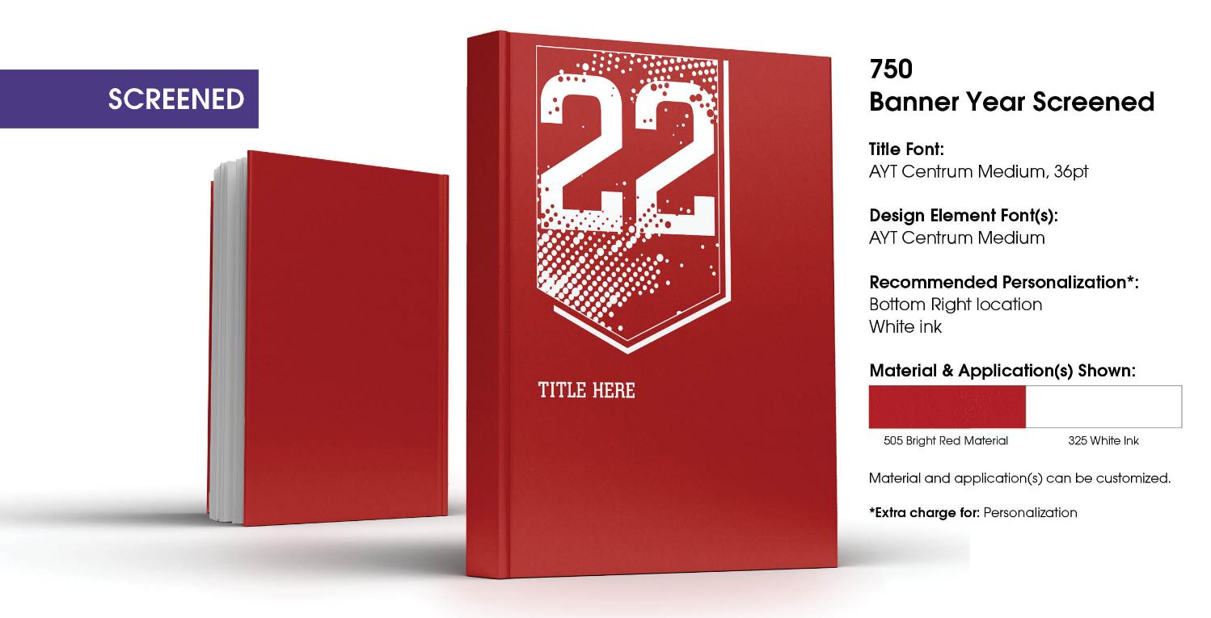

Slide 4
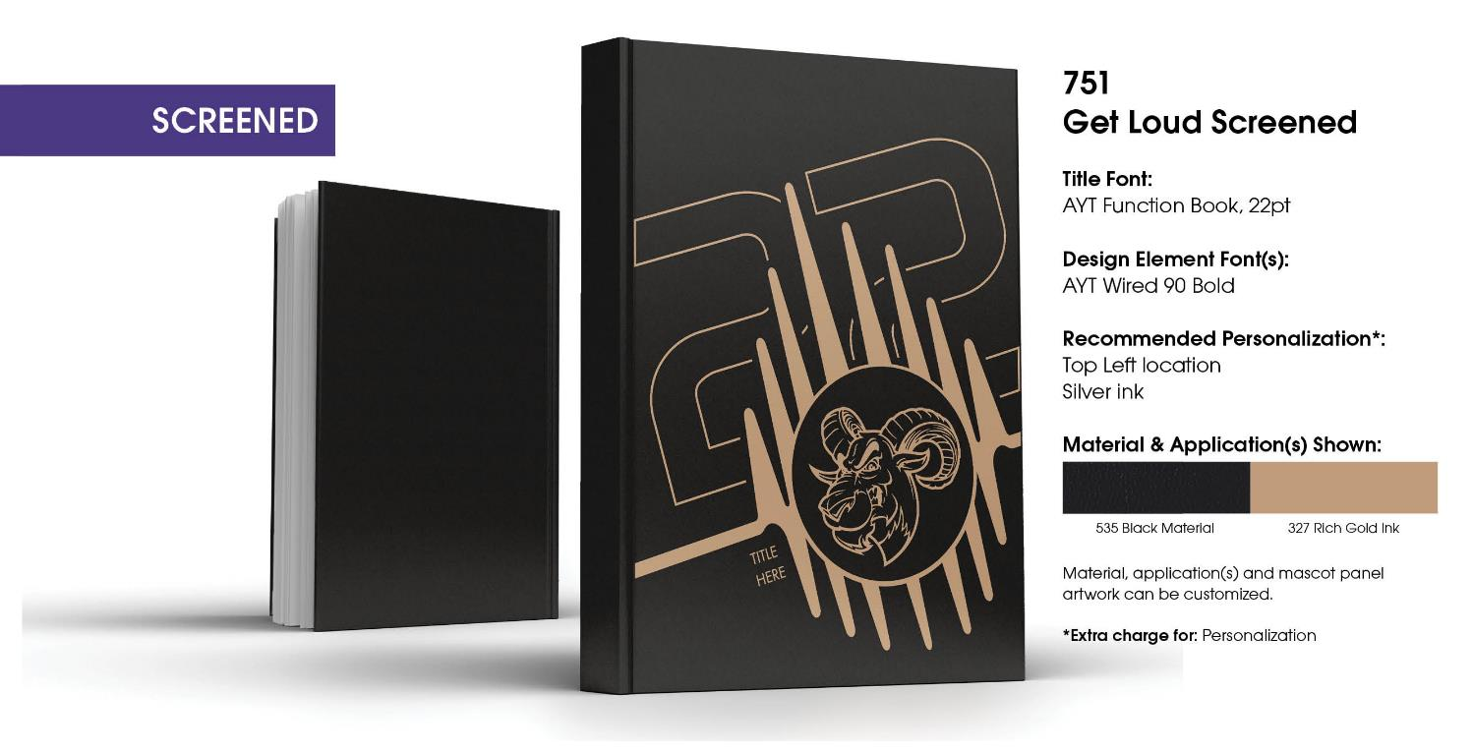

Slide 5
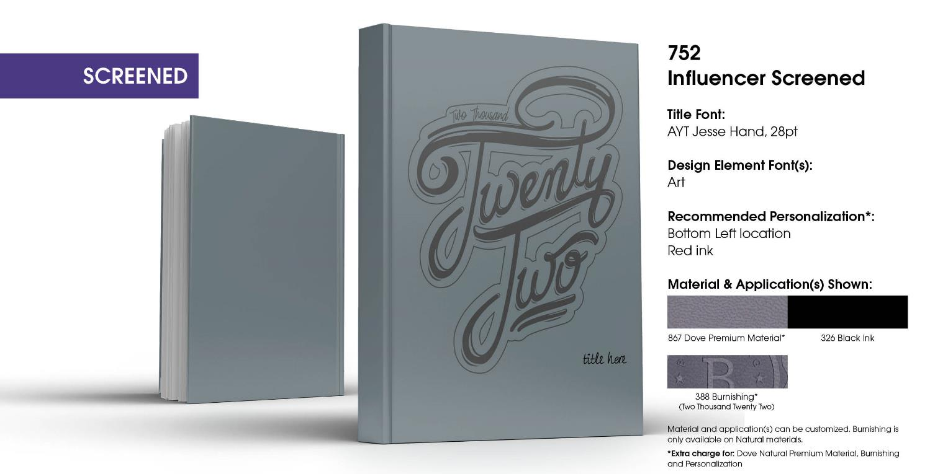

Slide 6
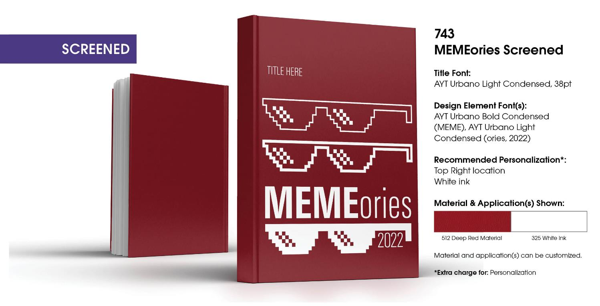

Slide 7
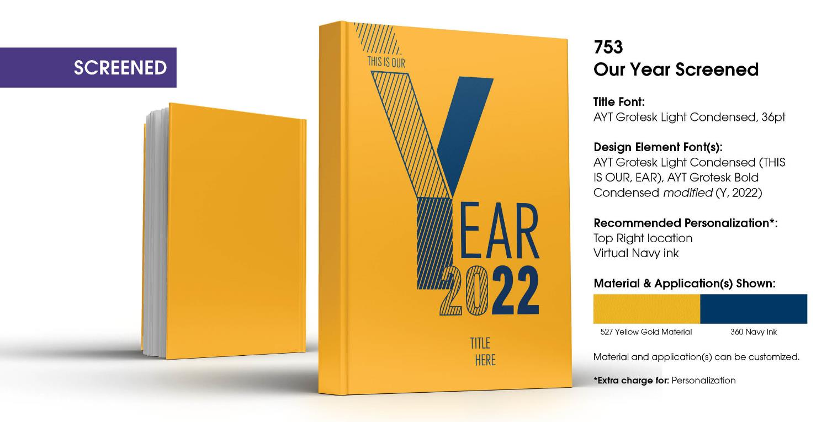

Slide 8
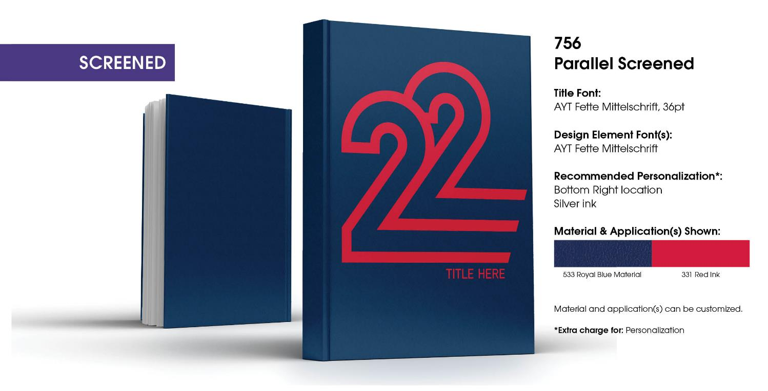

Slide 9
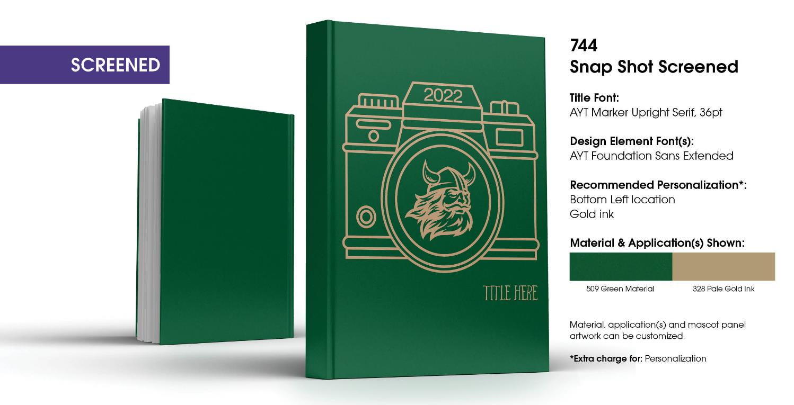

Slide 10
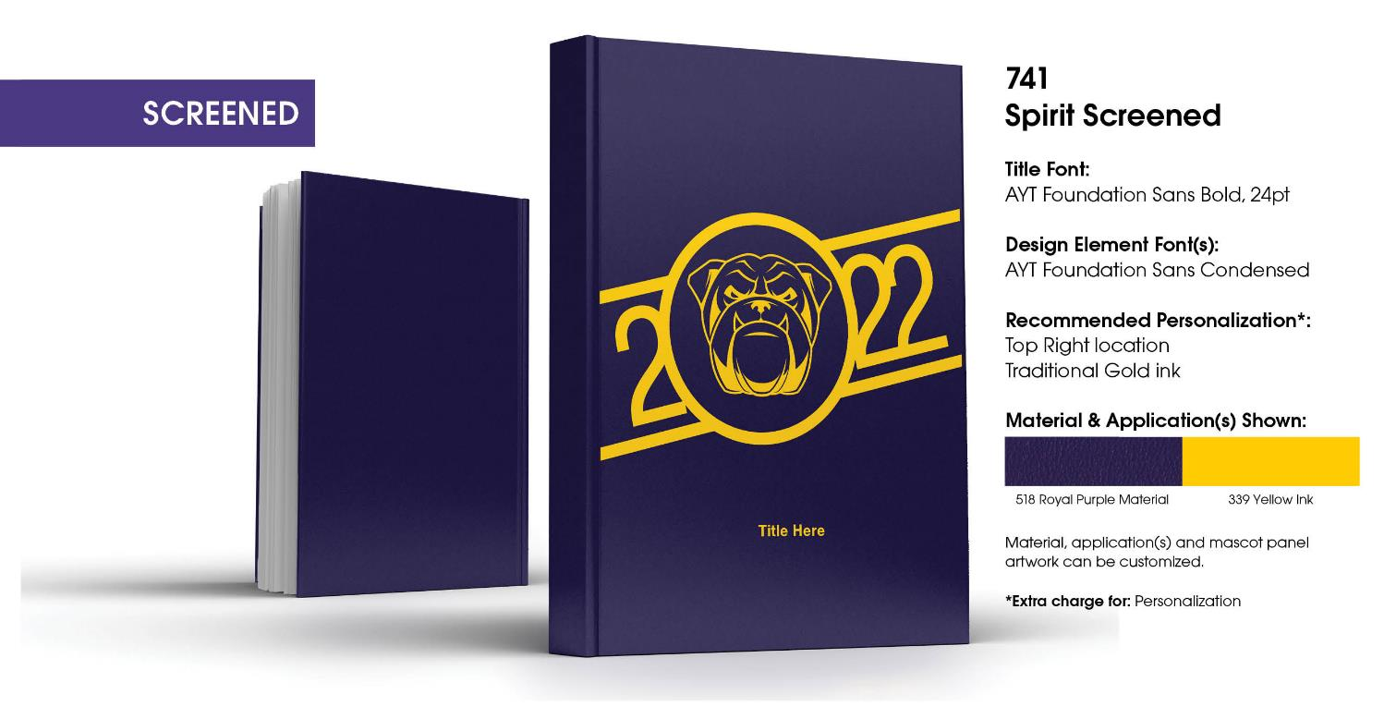

Slide 11
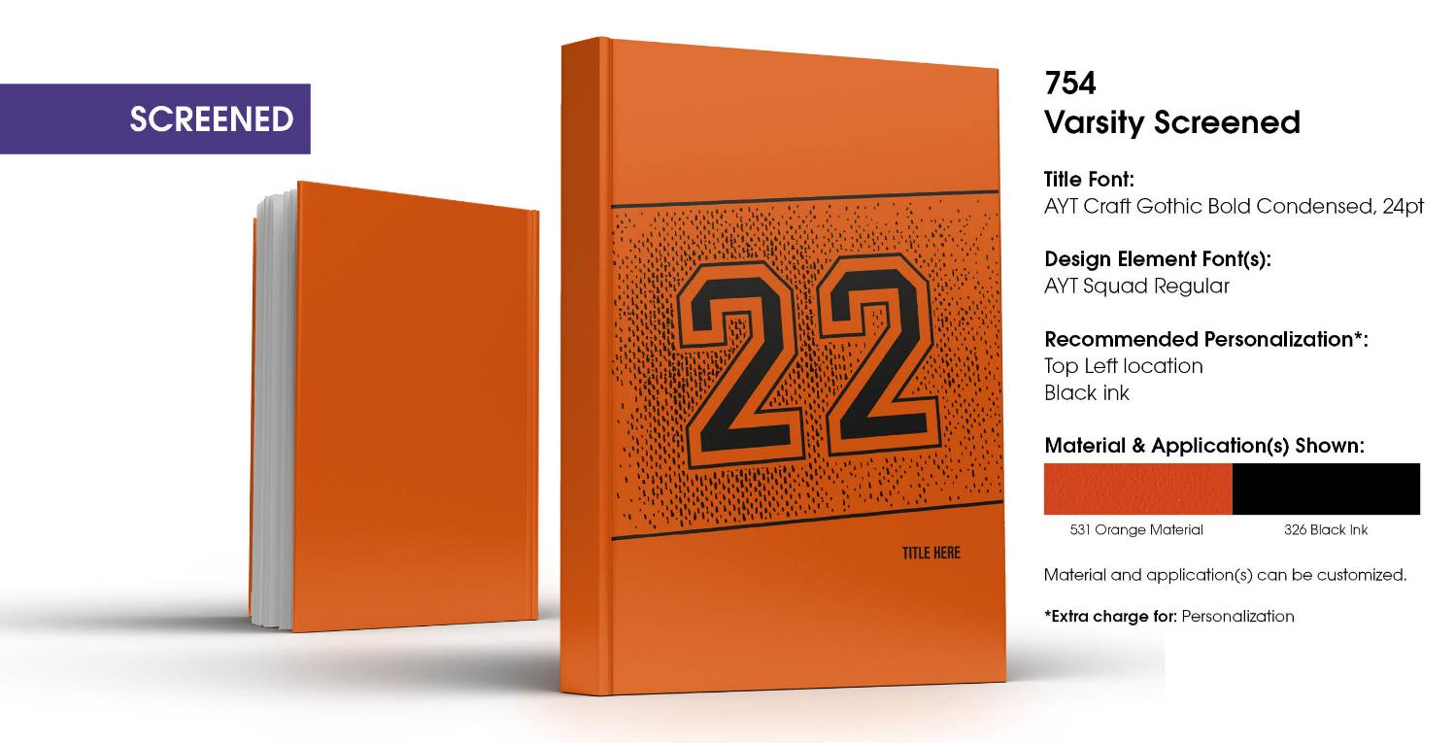

Slide 12
